Slide 1
AISC1003 Machine Learning I

Slide 2
Learning Outcomes – ML I – LR III – Sensitivity Analysis
You should understand the importance of understanding what data is
You will understand what a robust model looks like, and
Understand why it is important, as well as,
Understand how to verify a model is robust
You will see a worked example of Sensitivity Analysis

Slide 3
Exercises– Week 4
Same dataset, perform LR by Gradient Descent using Excel & Python. Compare to OLS.
Excel vs. Python? Pros/cons?
Tuning parameters vs. metrics/efficiency?
Optimal alpha?
What method is better?

Slide 4
Exercises– Week 4

Slide 5
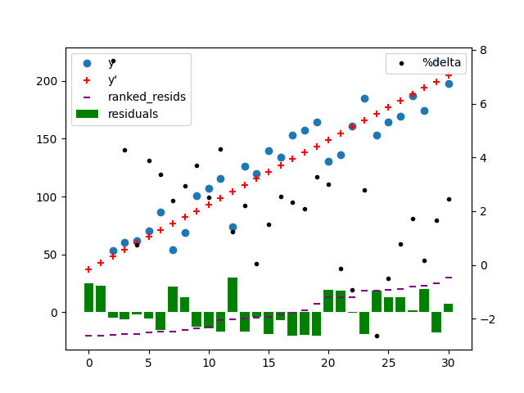
Exercises– Week 4
import pandas as pd
import numpy as np
import matplotlib.pyplot as plt
#Read excel file
df=pd.read_excel('exercises-wk2.xlsx')
#keep cols 2 and 3, rename columns per row 1, keep needed rows
df=df.iloc[:, 1:3]
df.columns = df.iloc[0]
df = df[1:32]
#slope, m=(Σy_{i}x_{i}-y̅_{i}Σx_{i})/(Σx_{i}²-x̅_{i}Σx_{i})
m=(sum(df["x"]*df["y"])-df["y"].mean()*sum(df["x"]))/(sum(df["x"] * df["x"])-df["x"].mean()*sum(df["x"]))
#b=y̅i-mx̅i
b=df["y"].mean()-m*df["x"].mean()
#Predictions
df["y_hat"]=df['x']*m+b
#residual analysis
df["residuals"]=df["y_hat"]-df["y"]
df["ranked_residuals"]=df["residuals"].sort_values(ascending=True).values
df["temp"]=(df["ranked_residuals"]+abs(df["ranked_residuals"].head(1).item()))
df["%jump"]=(df["ranked_residuals"]+abs(df["ranked_residuals"].head(1).item())).pct_change()*100
#r^2
rsqr=sum((df["y_hat"]-df["y"].mean())*(df["y_hat"]-df["y"].mean()))/sum((df["y"]-df["y"].mean())*(df["y"]-df["y"].mean()))
print('m:',m,' b:',b," rsqr:",rsqr)
print(df)
#graph
fig=plt.figure()
ax1 = fig.add_subplot(111)
ax1.scatter(df['x'],df['y'], marker='o', label='y')
ax1.scatter(df['x'],df['y_hat'], marker='+', color="red", label="y'")
ax1.bar(df['x'],df['residuals'], width=0.8, color="green", label="residuals")
ax1.scatter(df['x'],df['ranked_residuals'], marker='_', color="purple", label="ranked_resids")
plt.legend()
ax2 = ax1.twinx()
ax2.scatter(df['x'],np.log(df['%jump']), marker='.', color="black", label="%delta")
ax2.legend(loc=0)
plt.show()

Slide 6
Exercises– Week 4

Slide 7
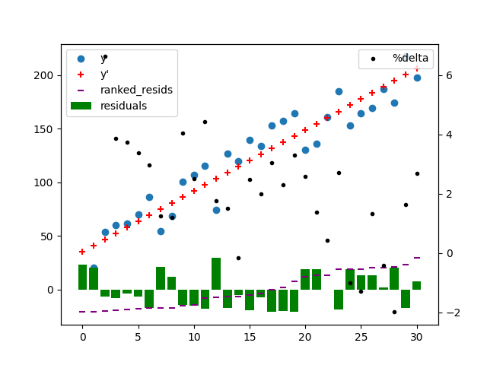
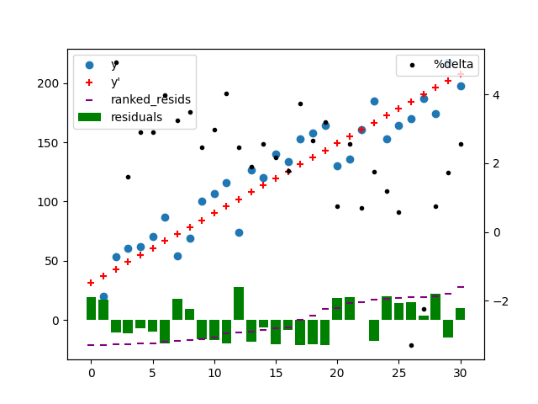

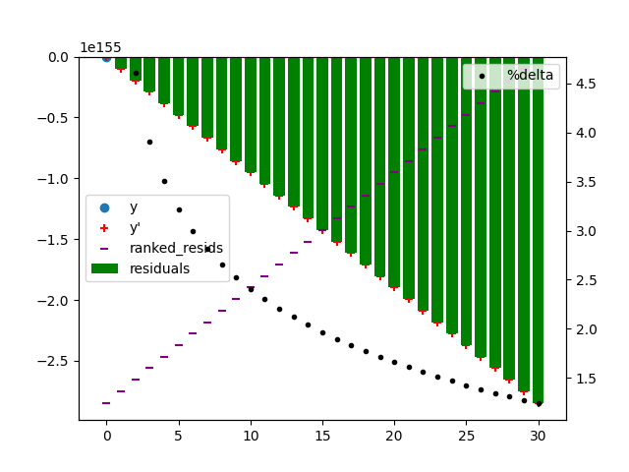
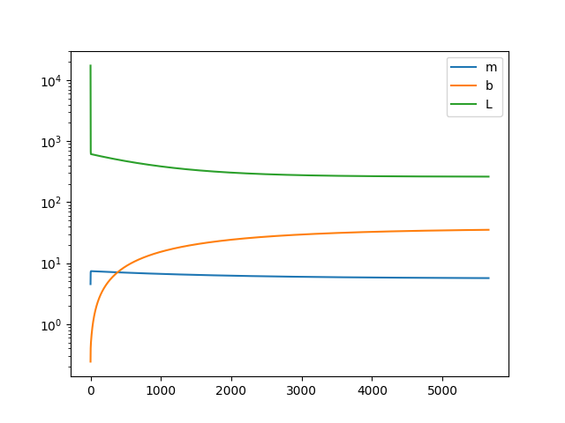
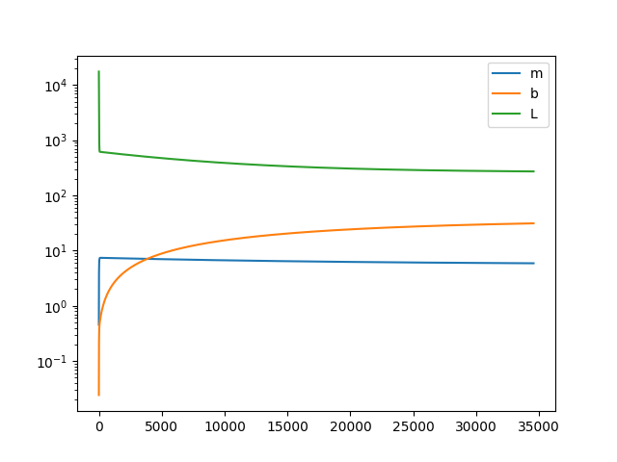
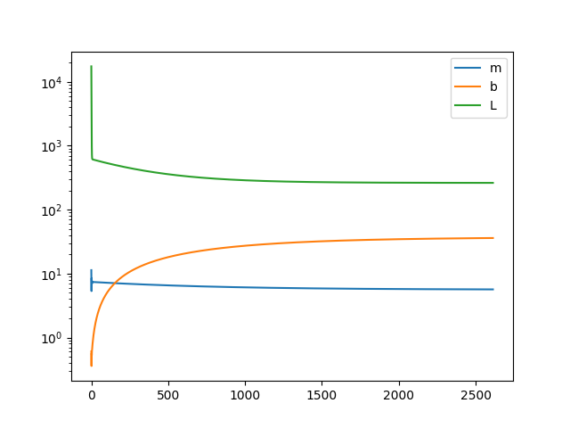
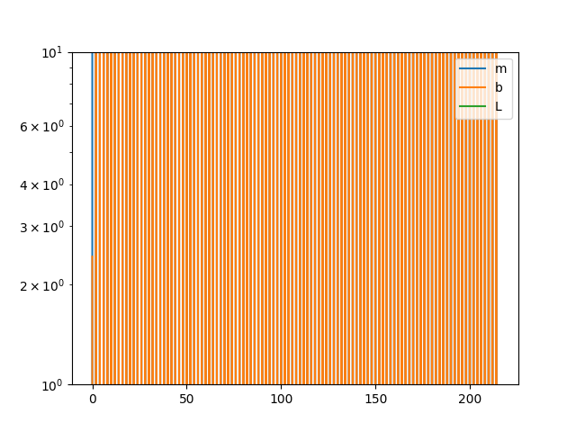
Exercises– Week 4
import pandas as pd
import numpy as np
import matplotlib.pyplot as plt
#Read excel file
df=pd.read_excel('exercises-wk2.xlsx')
#keep cols 2 and 3, rename columns per row 1, keep needed rows
df=df.iloc[:, 1:3]
df.columns = df.iloc[0]
df = df[1:32]
X=df['x']
Y=df['y']
#print(df)
#initialize parameters
m = b = Loss = 0
delL = 0.1
alpha = 0.0025
threshold = 0.001#precision needed in Loss
#loops = 10000 #iterations to perform gradient descent
dfresults=pd.DataFrame()
dfm=[]
dfb=[]
dfL=[]
N = len(X)
#Gradient Descent
#for i in range(loops):
while abs(delL) >= threshold:
Yhat = m*X + b
#partial derivs
delJ_m = (2/N)*sum(X*(Yhat-Y))
delJ_b = (2/N)*sum(Yhat-Y)
delM=m
delB=b
delL=Loss
m = m-alpha*delJ_m
b = b-alpha*delJ_b
Loss = (1/N)*sum((Yhat-Y)*(Yhat-Y))
delM=m-delM
delB=b-delB
delL=Loss-delL
dfm.append(m)
dfb.append(b)
dfL.append(Loss)
# print ("m,b, delM, delB, delL:",m, b, delM, delB, delL)
dfresults = pd.DataFrame(list(zip(dfm, dfb,dfL)), columns =['m', 'b', 'L'])
print(dfresults)
df['y_hat']=m*X+b
df['residuals']=df['y_hat']-Y
df['ranked_residuals']=df['residuals'].sort_values(ascending=True).values
df["%jump"]=(df["ranked_residuals"]+abs(df["ranked_residuals"].head(1).item())).pct_change()*100
#graph
fig=plt.figure()
ax1 = fig.add_subplot(111)
ax1.scatter(df['x'],df['y'], marker='o', label='y')
ax1.scatter(df['x'],df['y_hat'], marker='+', color="red", label="y'")
ax1.bar(df['x'],df['residuals'], width=0.8, color="green", label="residuals")
ax1.scatter(df['x'],df['ranked_residuals'], marker='_', color="purple", label="ranked_resids")
plt.legend()
ax2 = ax1.twinx()
ax2.scatter(df['x'],np.log(df['%jump']), marker='.', color="black", label="%delta")
ax2.legend(loc=0)
#plt.show()
fig2=plt.figure()
dfresults.plot(logy=True)
plt.legend(loc='best')
plt.show()

Slide 8
Learning Outcomes – ML I – LR III – Sensitivity Analysis
You should understand the importance of understanding what data is
You will understand what a robust model looks like, and
Understand why it is important, as well as,
Understand how to verify a model is robust
You will see a worked example of Sensitivity Analysis

Slide 9
MLI – Regression IV –Data
Numerical Scales of measurement:
characterized by a number, quantitative
interval (can’t × or ÷, but can look at differences and their × or ÷) or
continuous ratio characterized by a number that varies in some continuous way

Slide 10
MLI – Regression IV –Data
Quantitative Qualitative
Ratio
Interval
Ordinal
Nominal
-qualitative grouping of similar items in a CATEGORY without an inherent measure
-semi-quantitative grouping of similar items in an ORDERED category indicative of sequence/position, but not mathematically operable
-semi-quantitative grouping of similar items in an ORDERED category, in which the scale has equidistant intervals
-quantitative grouping of similar items in which members are directly comparable using measures

Slide 11
MLI – Regression IV ––Data
Non-parametric, histograms, graphs
Parametric (fit distribution), classical tools
Nominal
Interval
-postal codes, provinces, {happy, rude, laughy, grisâtre, surly, sad}, {tinker, tailor, soldier, spy}, colours, blood type, name, pass/fail, noun/verb, Eu/Prokaryotes, SIN…
-*happy: 1/5, 2/5…5/5; *Temperature (ºC/F); 54ºW; *date (23/02/15); *pH; *Colour wavelength;
Ordinal
Ratio
-1st,2nd,3rd; Pvt.,Sgt.,Lt.,Cpt; happy, happier,happiest; short,medium,long; *apple juice,banana,cereal; *pass/fail (success);*IQ; Pain/Exertion level; movie rating;
-height, number of cars on bridge before collapse, *Temperature (K), *time… , enzyme level, electric conductivity;
Maths: | Nominal | Ordinal | Interval | Ratio
frequency distribution. | Yes | Yes | Yes | Yes
median and percentiles. | No | Yes | Yes | Yes
add or subtract. | No | No | Yes | Yes
mean, standard deviation, standard error of the mean. | No | No | Yes | Yes
ratio, or coefficient of variation. | No | No | No | Yes

Slide 12
Data Type | Possible values | Example usage | Level/scale (of measure) | Distribution | Scale of relative differences | Permissible statistics | Regression analysis
binary | 0, 1 (arbitrary labels) | binary outcome ("yes/no", “T/F", “pass/fail”...) | nominal | Bernoulli | incomparable | mode, Chi-squared | logistic, probit
categorical | 1, 2, ..., K (arbitrary labels) | categorical outcome (specific blood type,political party, word, etc.) |  | categorical |  |  | multinomial logit/ probit
ordinal | integer or real # (arbitrary scale) | relative score, sig. only for creating ranking | ordinal | categorical?? | relative comparison | Mode, median, Chi-squared | ordinal regression(ordered logit/probit)
binomial | 0, 1, ..., N | # successes (e.g. Y votes) out of N possible | interval (?) | binomial, beta-binomial, etc. | additive?? | Mode, mean, median, std dev, correlation | binomial regression(logistic,probit)
count | Natural #s (0, 1, ...) | # items (calls, people, molecules, births etc.) in given interval/area/volume | ratio | Poisson, negative binomial, etc. | multiplicative | All stats for interval scales +: geometric & harmonic means, coeff of variation | Poisson, negative binomial regression
real-valued additive | real # | Temp., relative distance, location parameter, etc. (or approx., anything not varying over large scale) | interval | normal, etc. (usually symmetric about mean) | additive | mean, median, mode, std dev, correlation | Standard linear regression
real-valued multiplicative | positive real # | cost, income, size, scale parameter, etc. (esp. when varied over large scale) | ratio | Log-normal, gamma,exp’l, etc. (usually skewed) | multiplicative | interval scales +: geometric & harmonic means, coeff of variation | Generalized linear model w/logarithmic link

Slide 13
ML I –LR III – Sensitivity Analysis
Y(x_{i}) = mX + b
Choose m, b so that Y (x_{i}) is close to y_{i} for each data point.
}residual
y_{i}
Y(x_{i})
Cost Function:
J(m,b) = (1/n) Σ (Y(x_{i})-y_{i})²
Goal:
Minimize J(m,b)

Slide 14
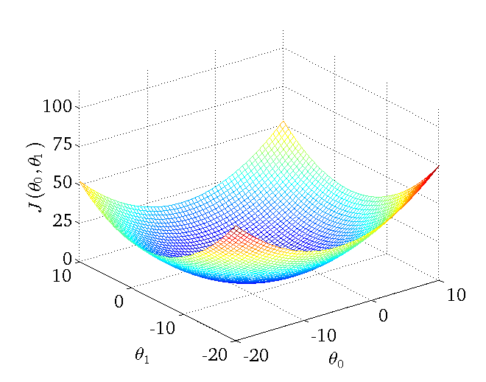
ML I –LR III – Sensitivity Analysis
Cost Function typically looks like this.
J(m,b) = (1/n) Σ (Y(x_{i})-y_{i})²
m b
Goal:
Minimize J(m,b)
Method:
Start with some m₀, b₀
Keep changing m & b to reduce J until we
hopefully end up at a minimum

Slide 15
ML I –Linear Regression II – Gradient Descent
The gradient is simply the SLOPE of the surface.
It is the sensitivity to the parameters in question.
It is the partial derivative with respect to the inputs.
J(m,b)₂ = J(m,b)₁ -α ∇ J(m,b)_{1 ,} ∇= gradient,
α= rate of approach
Large gradient → sensitive or not?

Slide 16
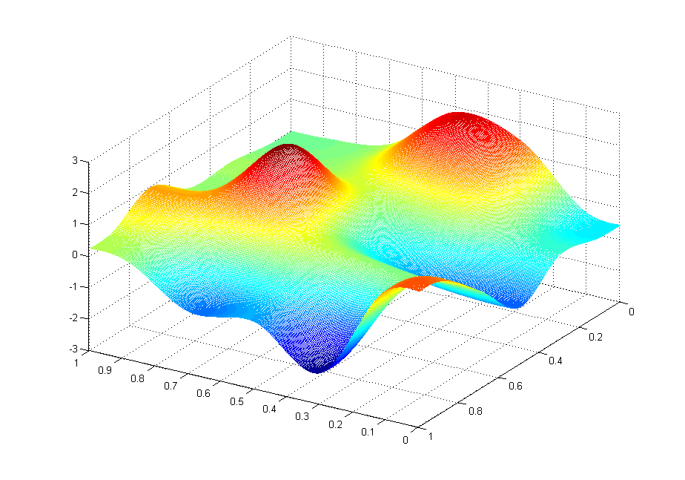
ML I –LR II – GD –Local vs Global Extremum
There may be more than one path:
What does this look like mathematically?

Slide 17

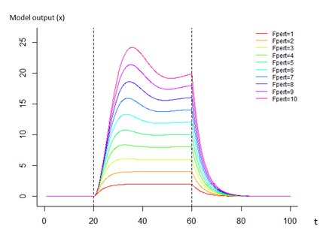
ML I –LR III – Sensitivity Analysis
Deals with the partitioning of uncertainty in our model output relative to our inputs
What we want to do is see how we perturb (disturb) our inputs and what effect that has on outputs
In other words, how does our output
respond to our input?
Barrier?

Slide 18
ML I –LR III – Sensitivity Analysis
Why?
-Model explanation (input-output variables correlate)
-Model refinement (reduce errors, input correlations)
-Model reduction (what is (not) important)
-Model optimization (probing)
-Model testing (stress testing)

Slide 19
ML I –LR III – Sensitivity Analysis
How?
-Ensembling methods (e.g. Monte Carlo) subsampling using many runs + ANOVA
-Selective parameter tuning (vary a parameter at a time)
-Graphical techniques

Slide 20
ML I –LR III – Sensitivity Analysis
Problems:
-Very resource intensive
-Input correlations of many variables
-Poor data samples (sampling) (noise + gaps)
-“ ” sample has to converge to the correct distribution, but so do subsamples (size?)

Slide 21
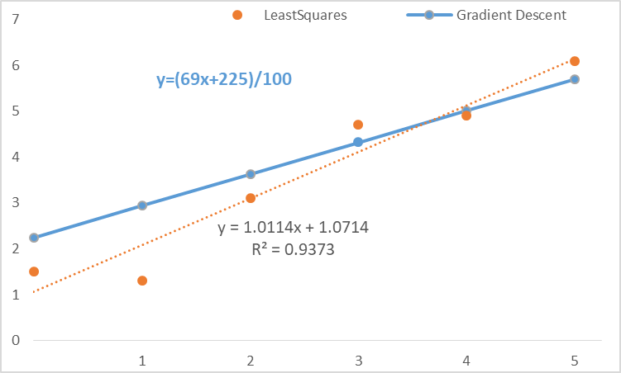
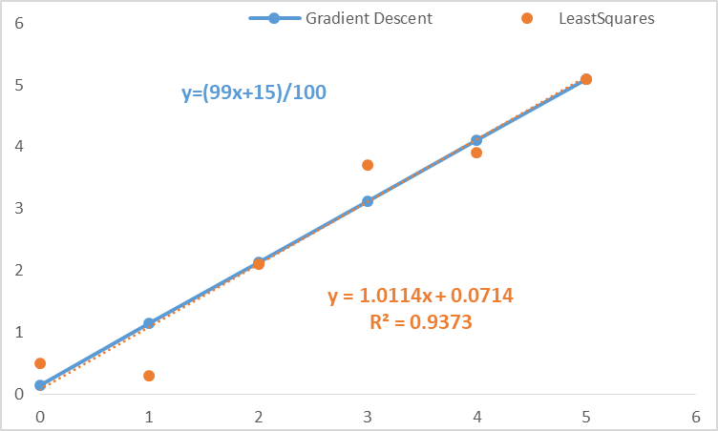
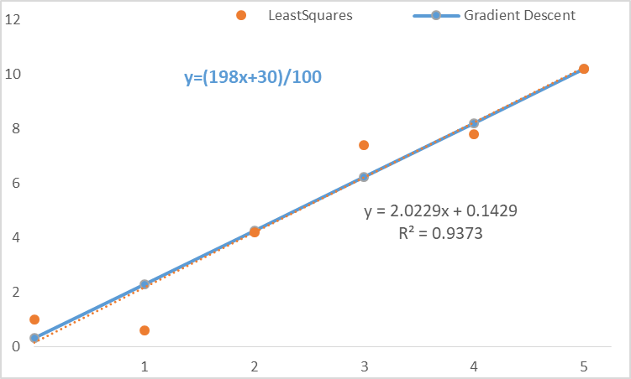
ML I –LR III – SA
x | y |  | x | 2y |  | x | y+1
0 | 0.5 |  | 0 | 1 |  | 0 | 1.5
1 | 0.3 |  | 1 | 0.6 |  | 1 | 1.3
2 | 2.1 |  | 2 | 4.2 |  | 2 | 3.1
3 | 3.7 |  | 3 | 7.4 |  | 3 | 4.7
4 | 3.9 |  | 4 | 7.8 |  | 4 | 4.9
5 | 5.1 |  | 5 | 10.2 |  | 5 | 6.1
Recall?

Slide 22
ML I –LR III – Sensitivity Analysis
The simplest way to run a sensitivity analysis is to partition the data and re-run to gain new parameter estimates
Choose a sample size of ½ of the data (this can also be varied to see how robust the model is)
For 21 data points, how many subsets are there?
For 21 data points, there are 2²¹-1 ~2.1M subsets
If we keep only those with 10 or 11 ~705K subsets

Slide 23
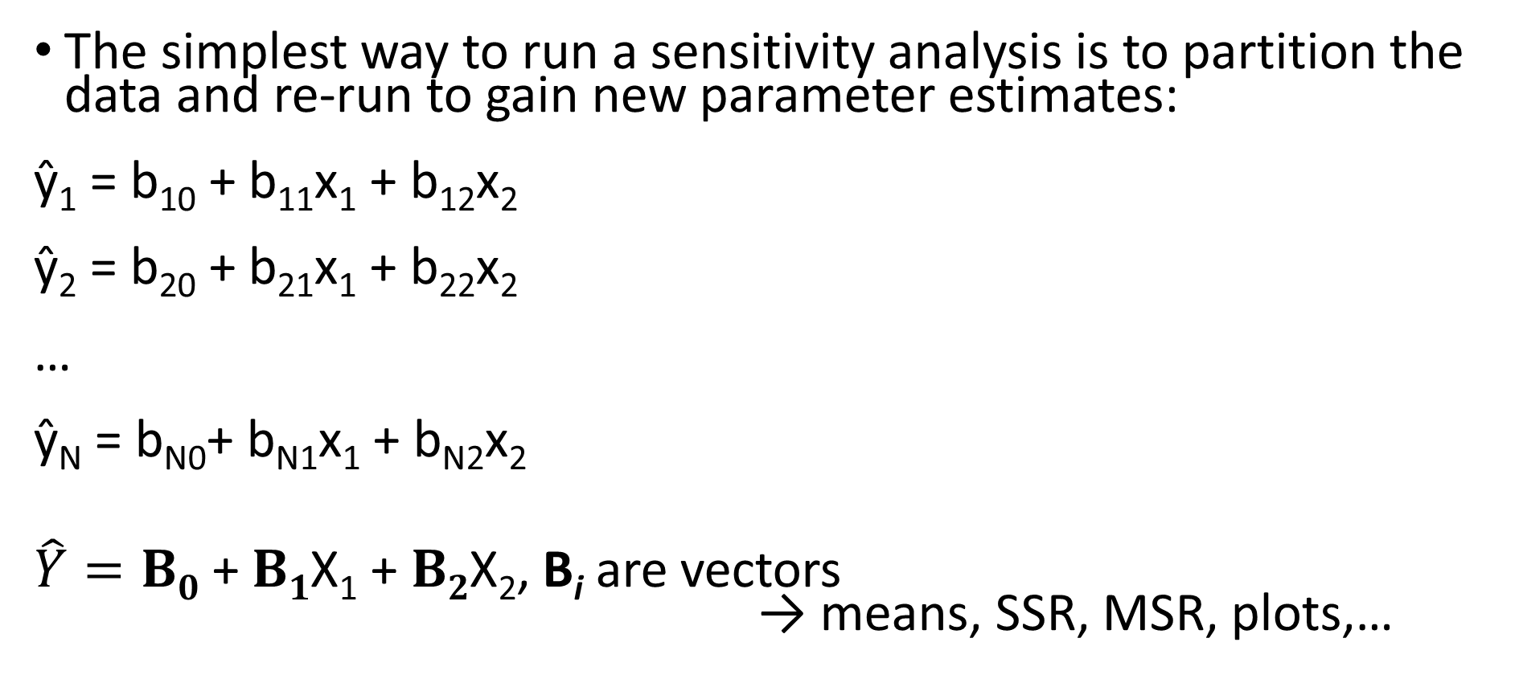
ML I –LR III – Sensitivity Analysis
The simplest way to run a sensitivity analysis is to partition the data and re-run to gain new parameter estimates:
ŷ₁ = b₁₀ + b₁₁x₁ + b₁₂x₂
ŷ₂ = b₂₀ + b₂₁x₁ + b₂₂x₂
…
ŷ_{N} = b_{N0}+ b_{N1}x₁ + b_{N2}x₂
$\hat{Y}=B0$ + $B1$X₁ + $B2$X₂, B_{i} are vectors
→ means, SSR, MSR, plots,…

Slide 24

ML I –LR III – Sensitivity Analysis
Let’s follow along an example*
_{y’ = a+bx}
_{*see companion excel file}

Slide 25
ML I –LR III – Sensitivity Analysis
Using the same dataset from Week 2/3/4, perform Linear Regression using Excel/Python.
Undertake a Sensitivity Analysis by choosing subsets.
Comment on the robustness of the model.
Redo the same with the extra dataset:
x | y | x | y | x | y
0 | -36.9077 | 11 | 694.4206 | 21 | -136.052
1 | 141.3608 | 12 | -518.993 | 22 | -964.232
2 | 53.47424 | 13 | -506.088 | 23 | -1477.86
3 | -605.227 | 14 | 719.6593 | 24 | 611.4941
4 | 247.4342 | 15 | -1399.1 | 25 | -164.476
5 | 563.4319 | 16 | 668.8244 | 26 | -1357.19
6 | 86.55053 | 17 | 1376.837 | 27 | 1870.767
7 | 488.5885 | 18 | -630.126 | 28 | -1044.84
8 | 207.068 | 19 | 492.692 | 29 | 2173.314
9 | 502.3497 | 20 | -1041.72 | 30 | 1980.507
10 | 320.7731

